Slide 1



Title: Web Scraping and Exploratory Data Analysis of Flats for Sale Across Hyderabad

Slide 2
About Me:
Iam P.Sireesha B.Tech graduate passionate about Data Analytics and Visualization.
Exploring data-driven insights through real-world datasets.
Interested in web data extraction and business trend analysis.
LINKEDIN: http://www.linkedin.com/in/sireesha-peruri-a5a91a227
GITHUB: https://github.com/perurisiri

Slide 3
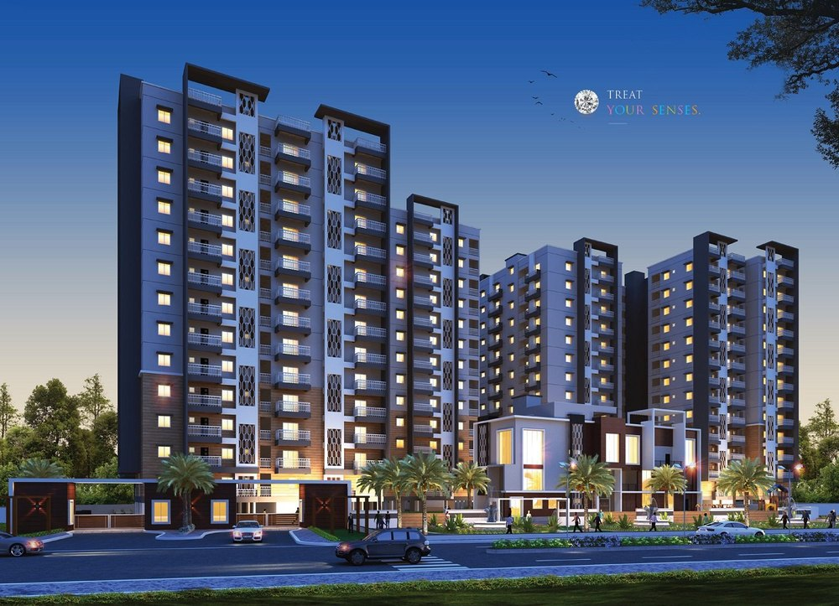
Introduction:
Buying a flat online is easy — but finding the right one among hundreds of listings is challenging.
Real estate platforms contain large amounts of scattered information that is difficult to compare manually.
That’s why I chose to scrape data — to turn messy website information into a clean, usable dataset.
Web scraping provides an automated way to collect data directly from websites without manual copying.
Through this project, I transformed raw web data into insights that help understand pricing trends, top locations, and buying patterns.

Slide 4

Business Problem:
Real estate buyers and investors face challenges in comparing property prices, configurations, and locations due to scattered online listings.
Property portals contain vast data, but manually analyzing it is time-consuming and inefficient.
Lack of structured insights makes it difficult to identify trends, price patterns, and high-demand areas.
There is a need for a systematic approach to extract, organize, and analyze property data for better decision-making.

Slide 5
Objectives:
To collect and analyze property listings for flats in Hyderabad using web-scraped data from real-estate websites.
To provide data-driven insights that help buyers, sellers, and analysts understand pricing trends, locality advantages, property sizes, and market patterns.
To explore locality-wise price variations, BHK configurations, price-per-sqft patterns, and factors influencing property valuation across Hyderabad.
To study market trends over time, compare flat availability across regions, and identify emerging high-demand or high-value localities in the city.

Slide 6
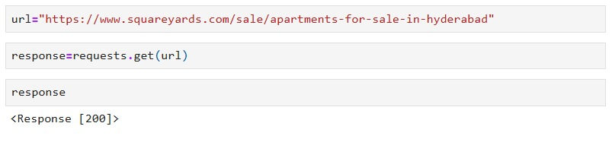
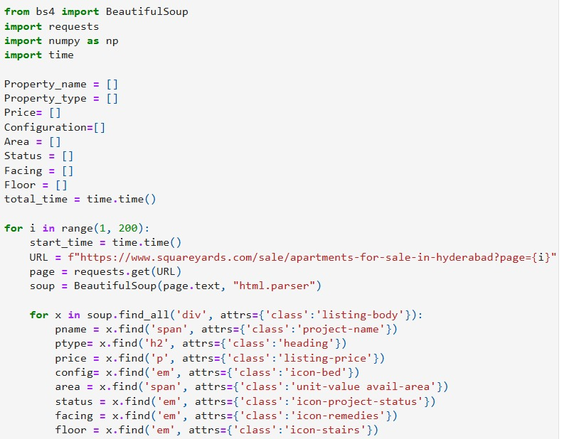
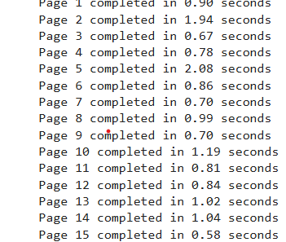
Web Scraping:
Collected real estate data for flats in Hyderabad from an Square Yards website.
Used Python (Requests + BeautifulSoup) to automatically extract data instead of manual copying.
Scraped key details such as Price, BHK, Location, Property Type, Area,Property_type and other property features.
Saved the extracted data into a structured CSV file for analysis.
After extraction, performed data cleaning and preprocessing to handle missing values, formatting, and duplicate entries.
Pagination logic was automated to scrape several listing pages without manual intervention.

Slide 7






Tools Used:

Slide 8
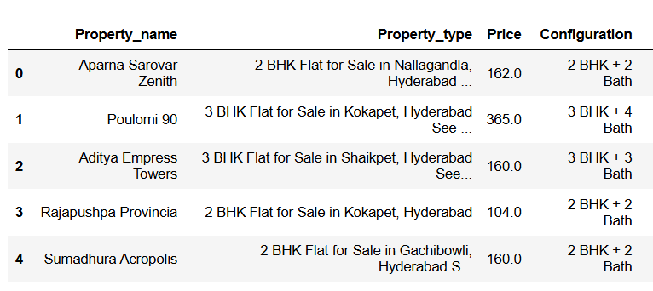
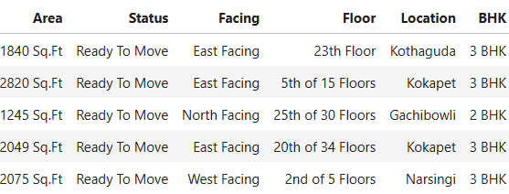
Data Cleaning Steps:
Removed unwanted characters like \n, commas, and symbols (₹, Sq.ft., etc.)
Extracted structured fields (BHK, Area, Location, Price) using regex.
Converted price values into a consistent numeric format (Lakhs).
Handled missing values using mean and mode where required.
Removed irrelevant records (like Studio or RK listings).
Standardized text formatting (lowercase, trimmed spaces).
Converted important columns from text to numeric type for analysis.

Slide 9
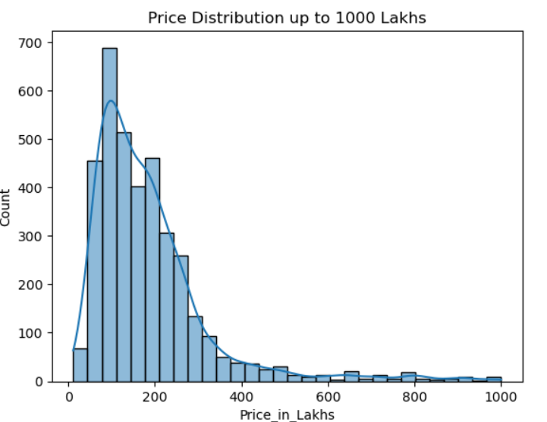
Data Visualization:
The histogram shows how flat prices are spread across the Hyderabad market.
The distribution is right-skewed, meaning most flats are in the lower price range.
Majority of listings fall between 80–250 Lakhs, indicating the most common and affordable segment.
Only a small portion of properties are priced above 400 Lakhs, representing luxury listings.
A few very high-priced properties (up to 1000 Lakhs) show the presence of ultra-premium flats.
Overall, demand is highest for mid-range properties, with fewer buyers and listings in the luxury segment.

Slide 10
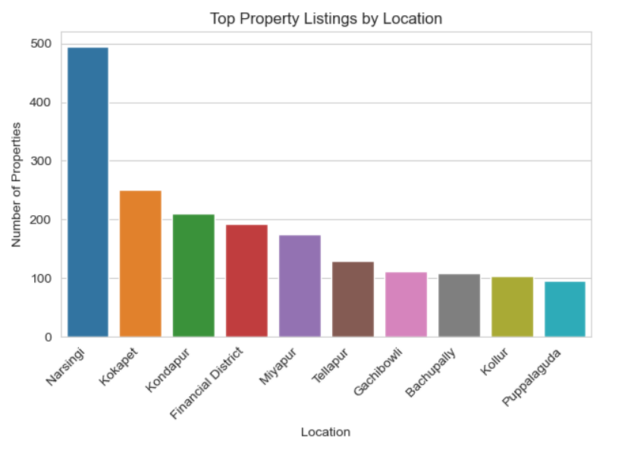
Data Visualization:
This bar chart shows the count of listed properties across major locations in Hyderabad.
Narsingi has the highest number of listings (around 500 properties), indicating it is currently one of the most active and in-demand real estate markets.
Kondapur and Kokapet rank next, with approximately 250–240 listings, showing strong residential development in these IT-connected areas.
Locations like Financial District, Tellapur, and Miyapur fall in the mid-range, reflecting growing but still developing property markets.
The lowest listings are observed in Kollur , Bachupally , Gachibowli, and Puppalaguda.

Slide 11
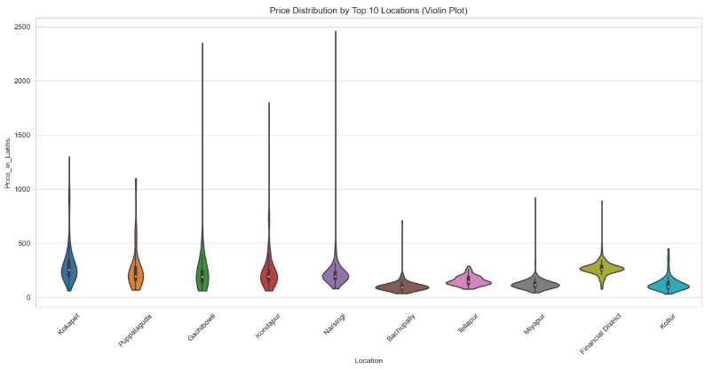
Data Visualization:
Violin plot shows price variation across top real-estate locations.
Kondapur, Gachibowli, Narsingi show the widest price ranges, indicating premium and diverse listings.
Bachupally, Miyapur, Kollur have more compact price ranges, showing affordability and price consistency.
Financial District has higher median prices with moderate spread.
Useful to identify high-variance locations vs stable pricing areas for buyers and investors.

Slide 12
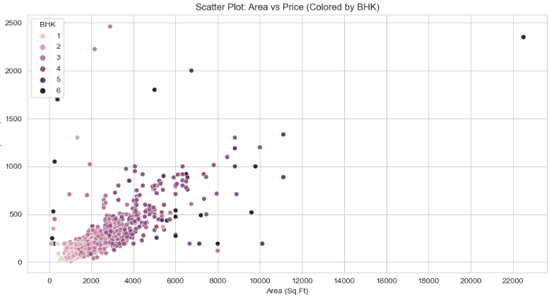
Data Visualization:
Scatter Plot Area vs Price (Colored by BHK) shows how property size relates to pricing across different BHK configurations.
Most properties fall between 500–4000 sq.ft in area and 50–700 lakhs in price, forming the main cluster.
The plot shows a strong positive relationship between area and price — larger homes generally cost more.
1–2 BHK units dominate the lower area and lower price segment, representing budget-friendly properties.
3–4 BHK homes appear in the mid-range, reflecting typical mid-premium residential options.
5–6 BHK properties are mostly found in higher area and price ranges, showing they belong to luxury categories.

Slide 13
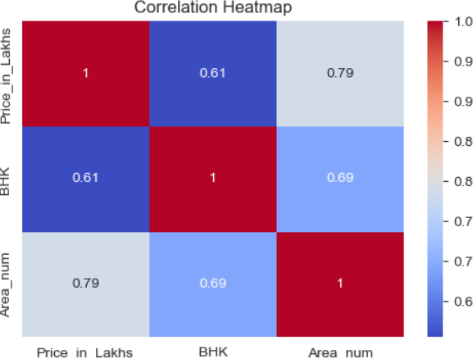
Data Visualization:
The heatmap displays the correlation strength between Price_in _Lakhs, BHK, and Area num.
Price and Area have the strongest positive correlation (0.79), meaning bigger flats usually cost more.
Price and BHK also show a moderate positive correlation (0.61), indicating higher BHK flats are generally more expensive.
Area and BHK correlate at 0.69, showing larger homes typically have more bedrooms.
Overall, all variables are positively related, with Area being the biggest driver of price.

Slide 14
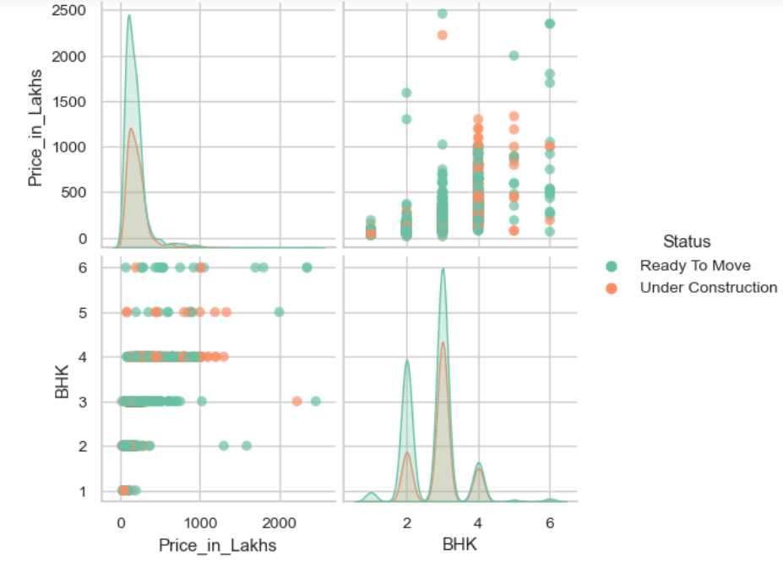
Data Visualization:
An upward trend shows that Price increases with BHK and Area.
The pair plot compares Price, BHK, and Area based on Property Status (Ready vs Under Construction).
Price distribution is right-skewed, with most flats in lower price ranges.
Ready-to-Move properties appear more often in higher-priced categories.
2BHK and 3BHK clusters are the most common across both types.
An upward trend shows that Price increases with BHK and Area.
Under-construction homes have a more consistent price range, while Ready homes show greater price variation.

Slide 15
Key Business Questions
What is the price distribution of flats in Hyderabad?
Which locations have the highest and lowest average property prices?
How do price trends vary based on BHK configuration?
Do Ready-to-Move properties cost more than Under-Construction ones?
What price range is most suitable for budget, mid-range, and luxury buyers?

Slide 16
Experience– Web Scraping & Data Analysis:
Scraped Square Yards data from multiple websites pages using Python (BeautifulSoup, pandas).
Cleaned and standardized data (area, price, BHK).
Created visualizations showing locality-wise price variations, BHK configurations, price_per_sqft patterns, and factors influencing property valuation across Hyderabad
Learned end-to-end data workflow: scraping → cleaning → analysis → visualization.

Slide 17
Challenges – Web Scraping & Data Analysis:
Handling inconsistent text formats (₹, Cr, Lakh, ranges, unwanted symbols).
Extracting structured values like BHK, Price, and Area using regex.
Cleaning missing and noisy data such as "Price on Request" and blank fields.
Overcoming request blocks and slow scraping.
Structuring the dataset for visualization and meaningful insights.
Choosing the most meaningful visuals for insights.

Slide 18
Q&A

Slide 19


